Slide 1
Personal Project UFC:NOW Alex Thain

Slide 2

UFC:NOW
This is a reactive Website utilising the skills I have learnt throughout my time on the course so far.

Slide 3
PROJECT PLAN
EDIT IN GOOGLE SLIDES
Click on the button under the presentation preview that says "Use as Google Slides Theme".
You will get a copy of this document on your Google Drive and will be able to edit, add or delete slides.
You have to be signed in to your Google account.
EDIT IN POWERPOINT®
Click on the button under the presentation preview that says "Download as PowerPoint template". You will get a .pptx file that you can edit in PowerPoint.
Remember to download and install the fonts used in this presentation (you’ll find the links to the font files needed in the Presentation design slide)

Slide 4
Steps to Project Completion
Plan
Create a MySQL Database (What the app functionality is built around)
Create Back-End of applcication. (Build Spring Boot and Test)
Create JavaScript files to accompany the applications functionality. In my case it was retrieving fighters by ID or Category via buttons in my HTML.
Source a bootstrap template. This provided me with a starter for a stylish webpage.
Re-Designed HTML Code & CSS Files to demo my skills.
Apply Javascript files that work along the Page to give it functionality (searching, purchasing, logging in)
Stay with me & I will show you more.

Slide 5
MY CONCEPT
The concept is very simple and could be reapplied to other sports or interests.

Slide 6
UFC:NOW is a fan site that also sells Gear & Merchandise
Fighters
This is the fan side of the site. All of my functionality relating to the atheletes is here. Including Searching by Name to reveal information about that athelete on the main page and also searching by category on the Fighters (Weight Classes) page.
Shop
The main functionality of this shopping section is to display merchandise and training gear for purchase by customers.
There is also a log-in function.

Slide 7
IN TWO OR THREE COLUMNS
Yellow
Is the color of gold, butter and ripe lemons. In the spectrum of visible light, yellow is found between green and orange.
Blue
Is the colour of the clear sky and the deep sea. It is located between violet and green on the optical spectrum.
Red
Is the color of blood, and because of this it has historically been associated with sacrifice, danger and courage.

Slide 8
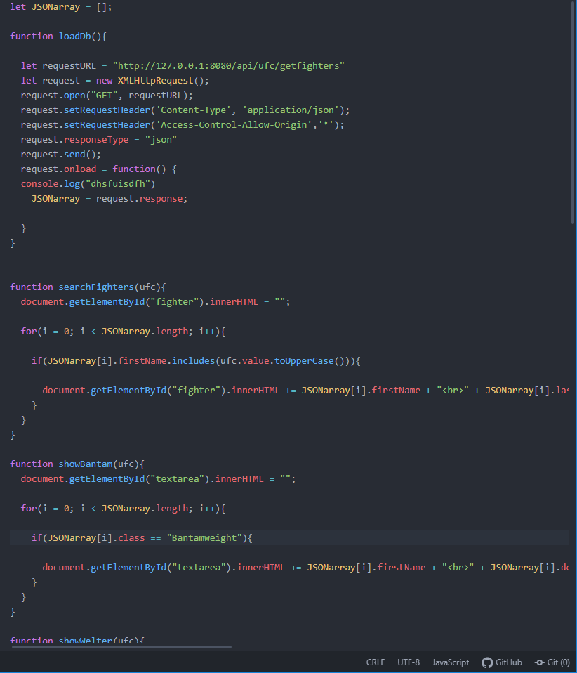
Example of Javascript - Functionality
This code to the left is the onLoad function to load the Database & Springboot App to the HTML on load.
Below that is the code used to search Fighters when typing any letter from a first name of someone in my DB.

Slide 9
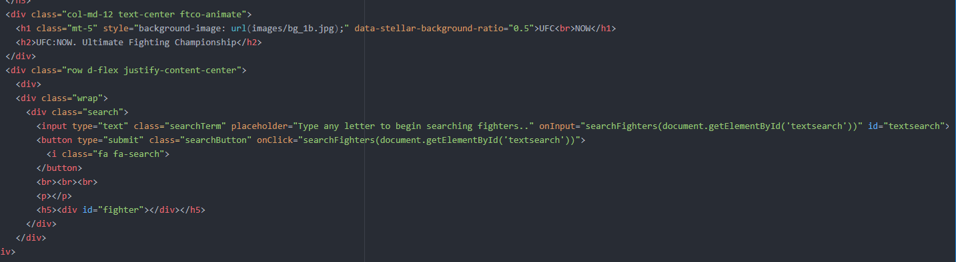
Example of JavaScript function implemented in HTML code
Here you can see the onClick function and onInput functions integrated into my HTML code for the Search Bar and the Button.
This search bar acts as a quick way to find a favourite fighter of yours. You will see there full name, DOB, Place of Birth and other info about them.

Slide 10

Want big impact?
Use big image.

Slide 11
TEST RESULTS THROUGHOUT MY PROJECT
Junit | % | % | % | % | %
JPA Data Test | % | % | % | % | %
Static

Slide 12
Coverage Explained
Throughout my project I used different testing techniques that I’ve learnt throughout the course so far. These included Junit, JPA Data and static tests. These static tests include SonarQube and Peer Review to ensure my code is reusable and good quality.
You can see in the slide previous that I have met the industry standard test coverage requirement of 70% in all my tests.

Slide 13
MAPS
My Office

Slide 14





£0
5 users
100%
Total to create this application
Users I have tested the site with
Total success!

Slide 15
OUR PROCESS IS EASY
first
second
last

Slide 16
CONCEPTS I IMPLEMENTED
MySQL
I used MySQL as the basis for my database. I had 4 tables which included UserInfo, Fighters, ShoppingBasket & Shop.
JavaScript
This is where I wrote functionality for the web page. The JS file does functions such as occurences when buttons are clicked or Elements are navigated etc.
HTML
I this is where the code is written for the actual front end page design. I used bootstrap as a basis for a stylish page which I heavily modified to make my own and show off my skills.
CSS
I used CSS for my Front-End this is the stylesheet that sets style and format to the items in my HTML Page.
Spring Boot
This is where I used Java code in Eclipse IDE to connect/access my SQL database so that I could use its data in my Front-End.
Java
This is the main language I used on the project when I was writing the code in my IDE. This is how I utilised the Spring Boot Application.

Slide 17
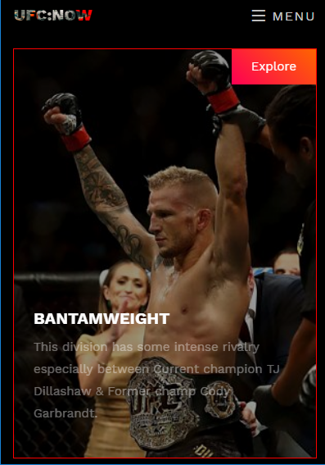
Adaptive Site: iPHONE This screenshot is a demonstration of how my project would look on an iPhone or infact any mobile device when viewed on the internet.
Place your screenshot here

Slide 18
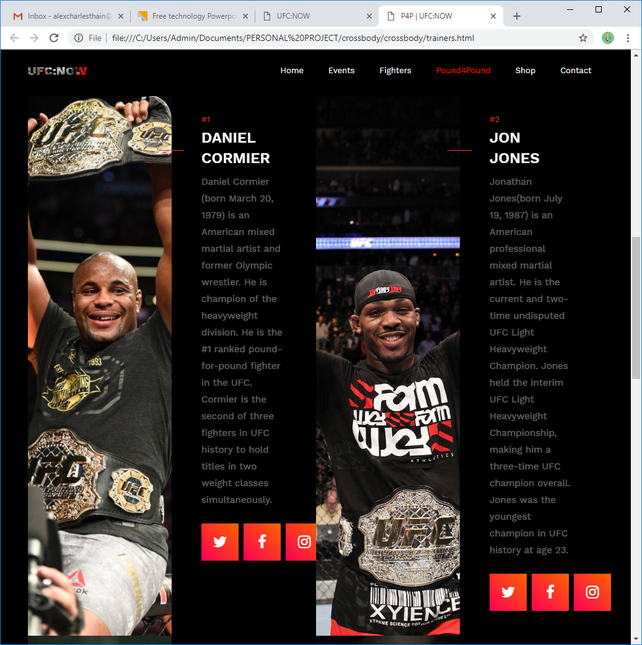
TABLET PROJECT
This screenshot is a demonstration of how my project would look on a Tablet when viewed on the internet.
Place your screenshot here

Slide 19
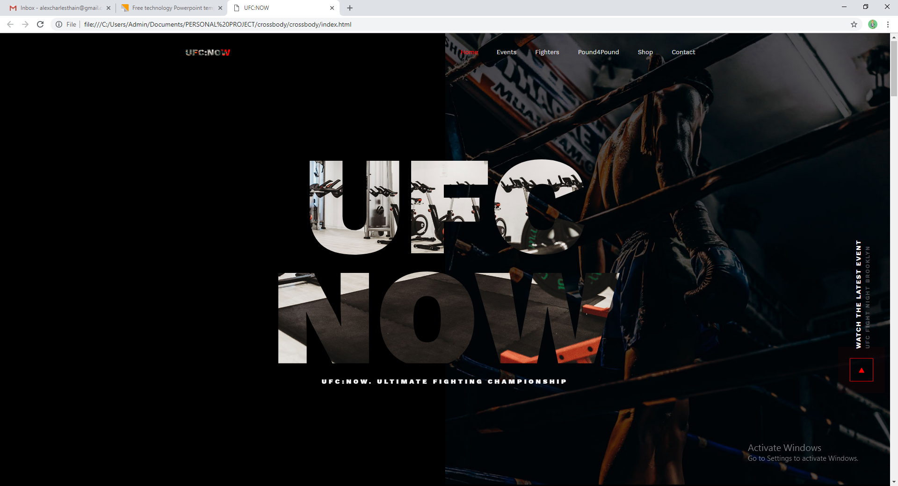
DESKTOP PROJECT
This screenshot is a demonstration of how my project would look on a Computer when viewed on the internet.
Place your screenshot here

Slide 20


THANKS FOR LISTENING!
Any questions?
You can find me and the project on Github at:
Github.com/alexcharlesthain
alexcharlesthain@gmail.com

Slide 21
SlidesCarnival icons are editable shapes.
This means that you can:
Resize them without losing quality.
Change fill color and opacity.
Change line color, width and style.
Isn’t that nice? :)
Examples:

